Slide 1
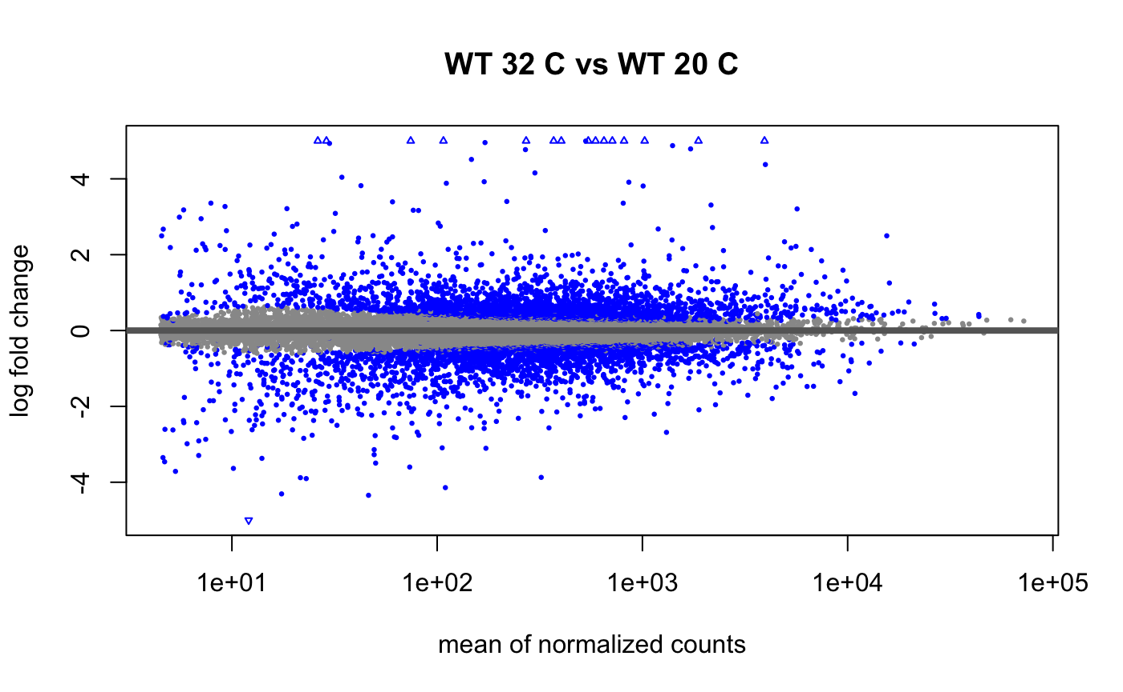
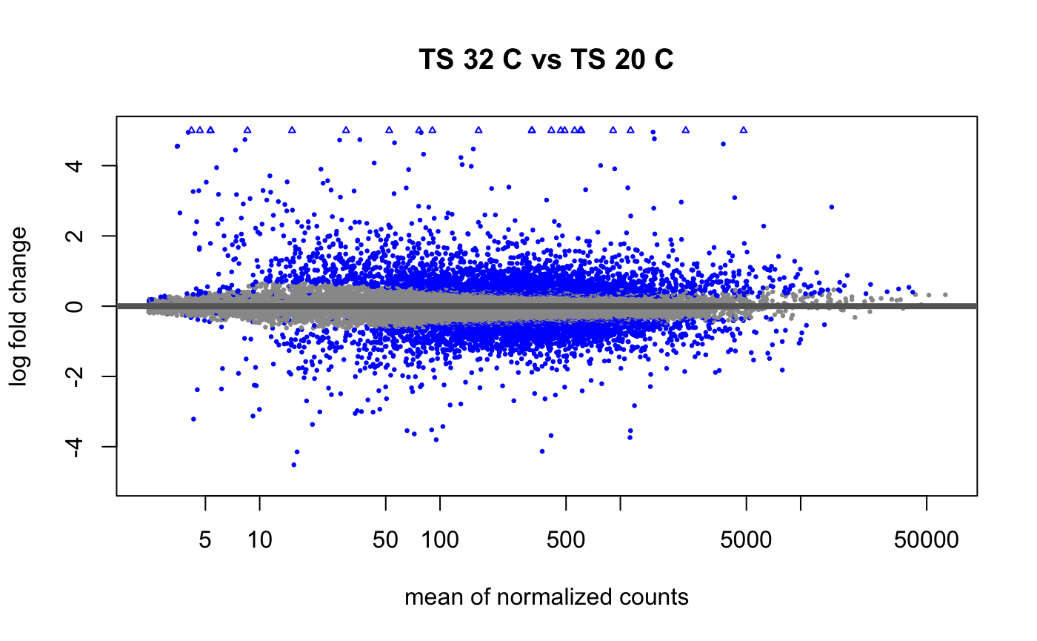
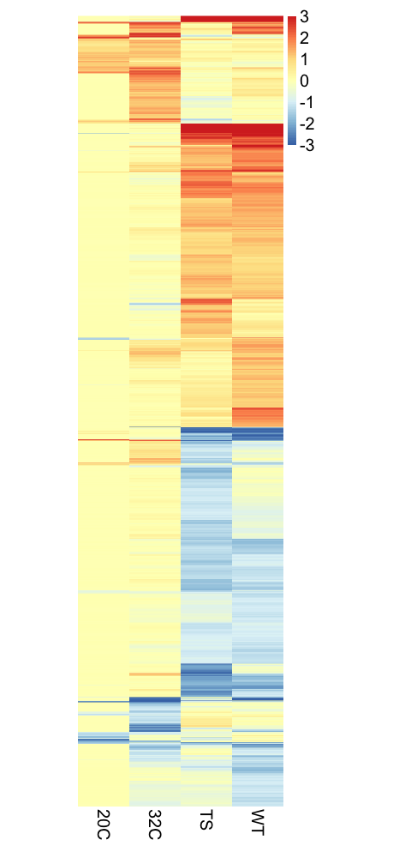
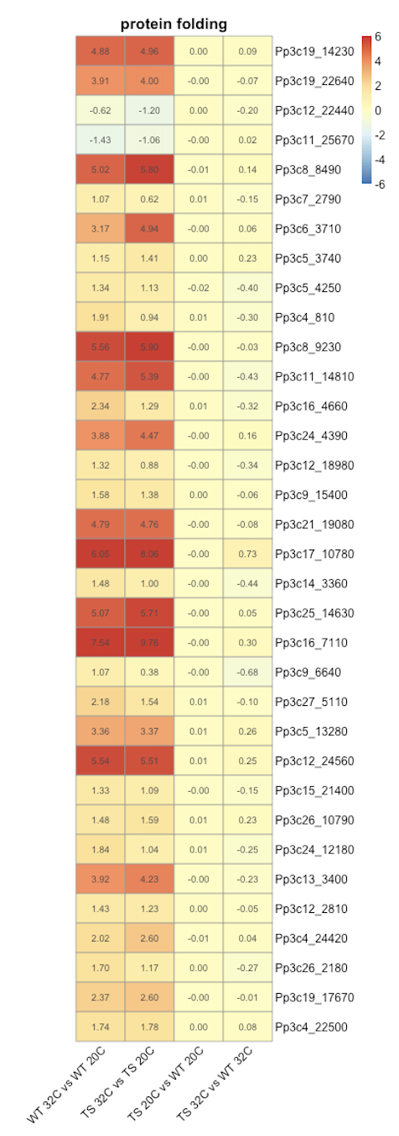
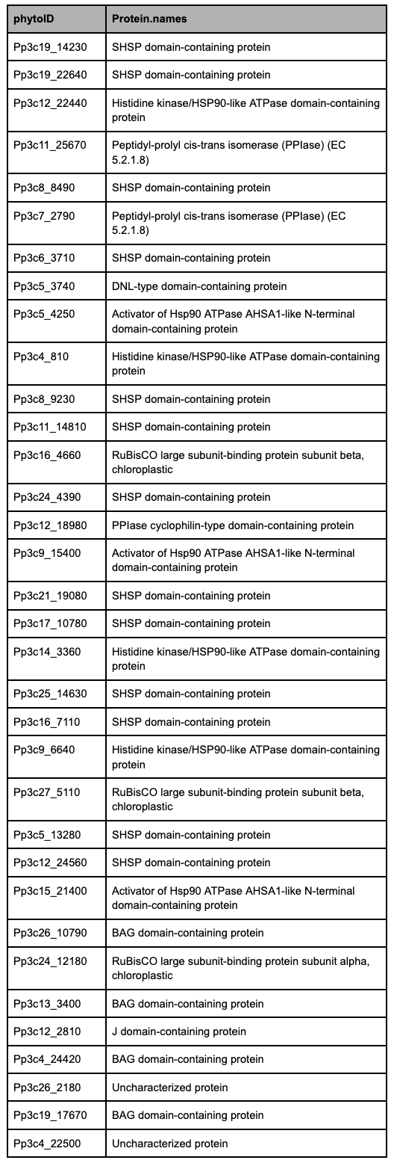
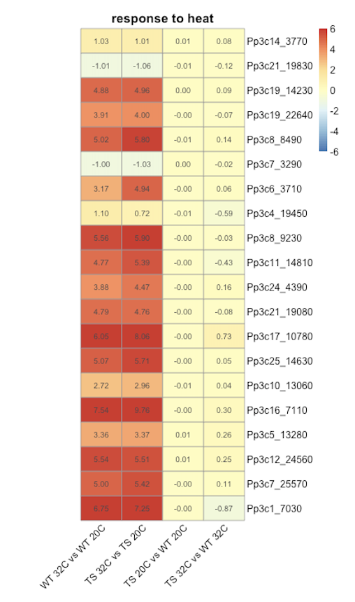
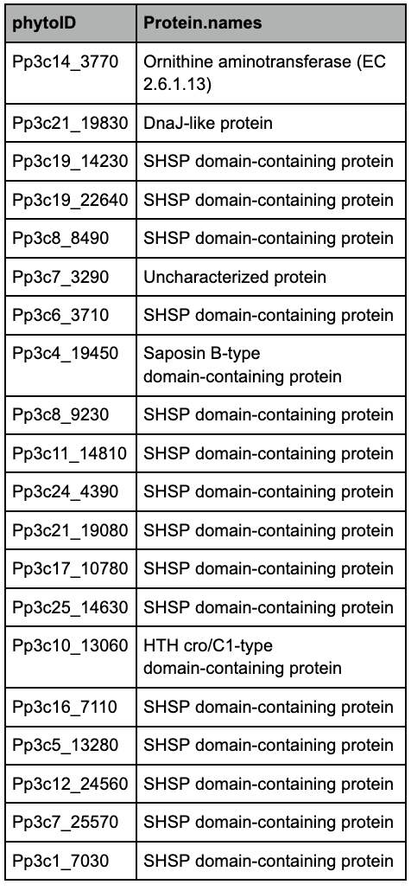
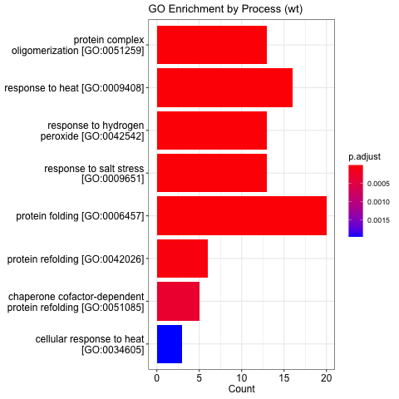
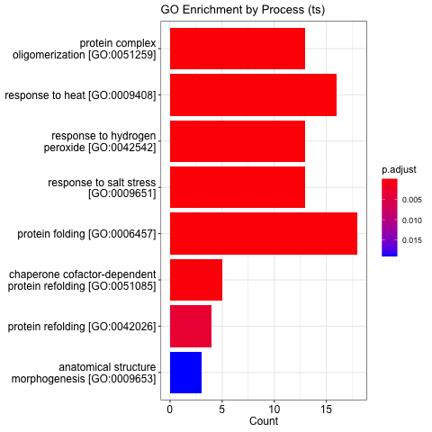
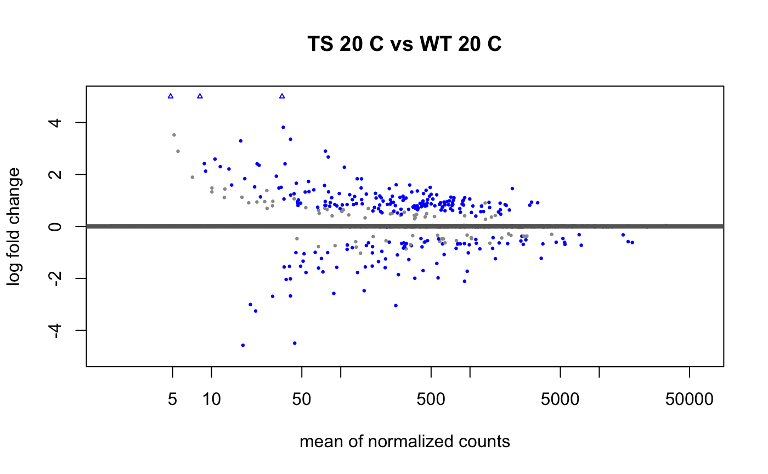
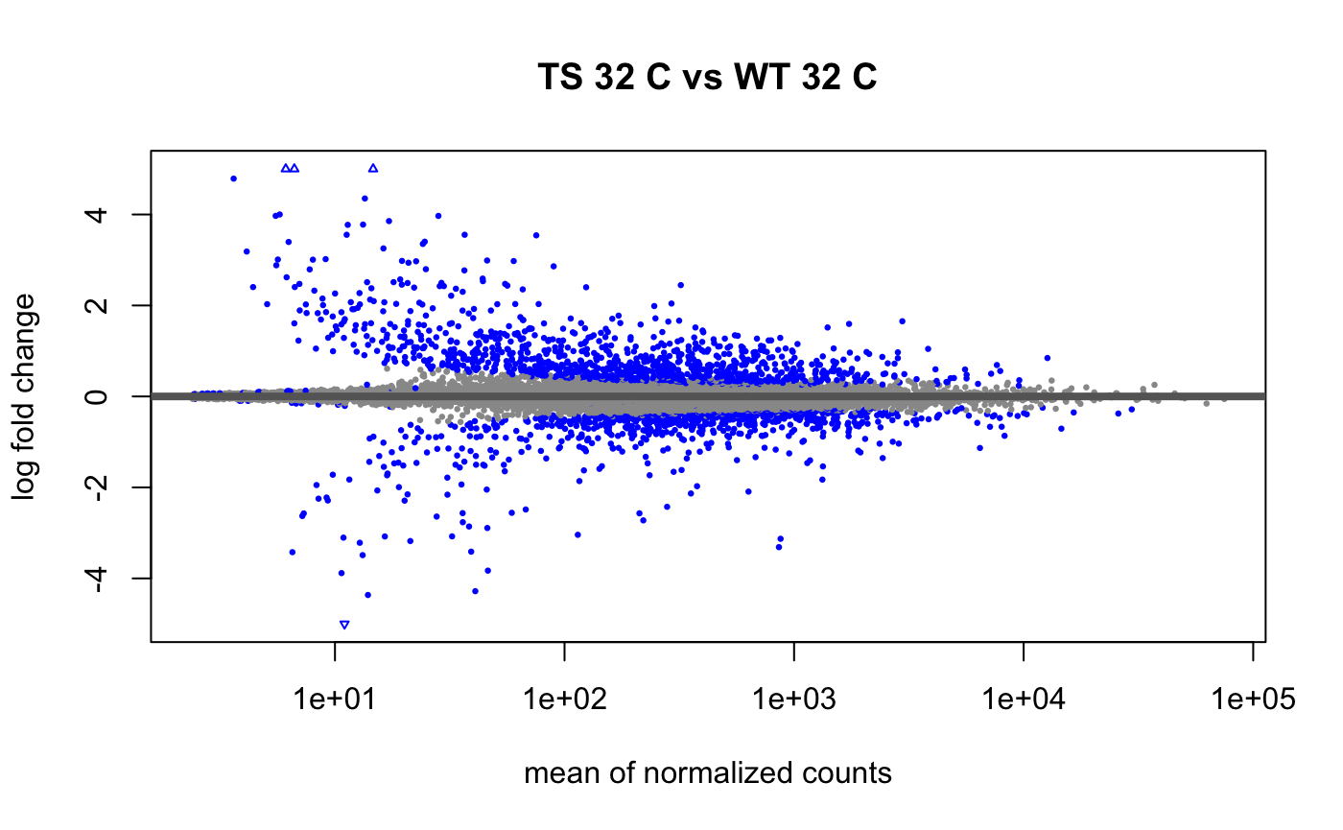
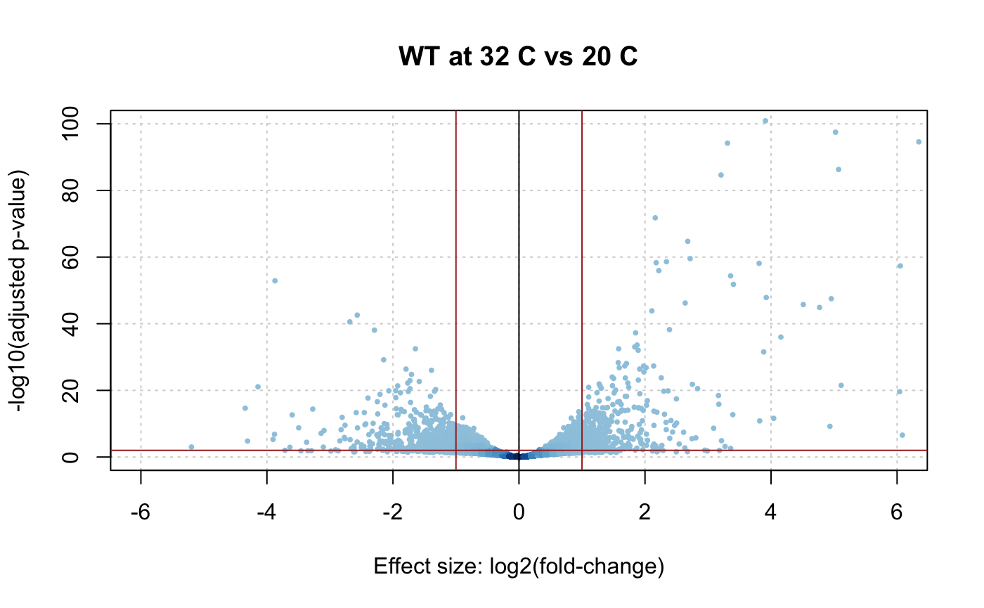
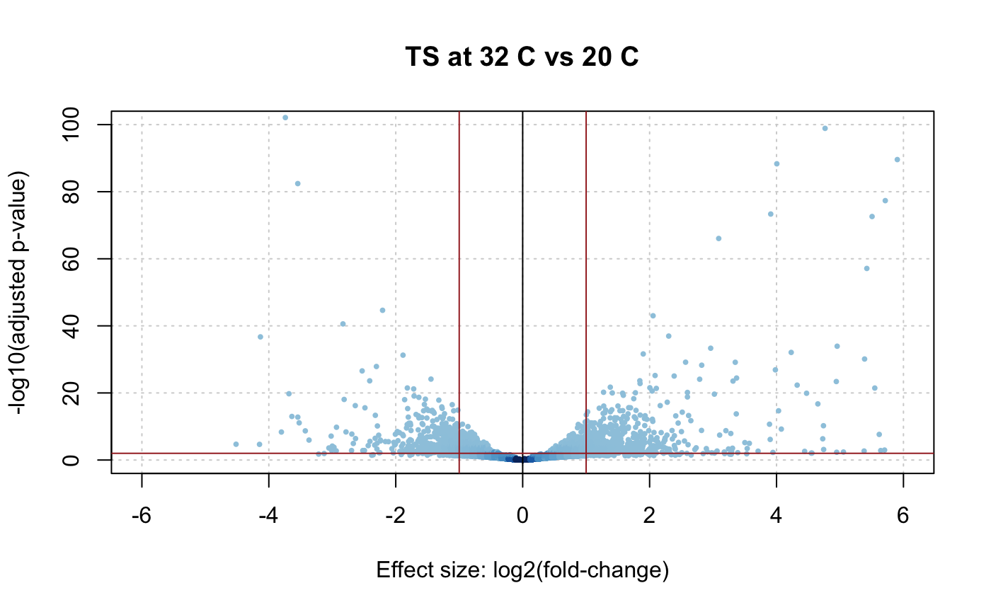
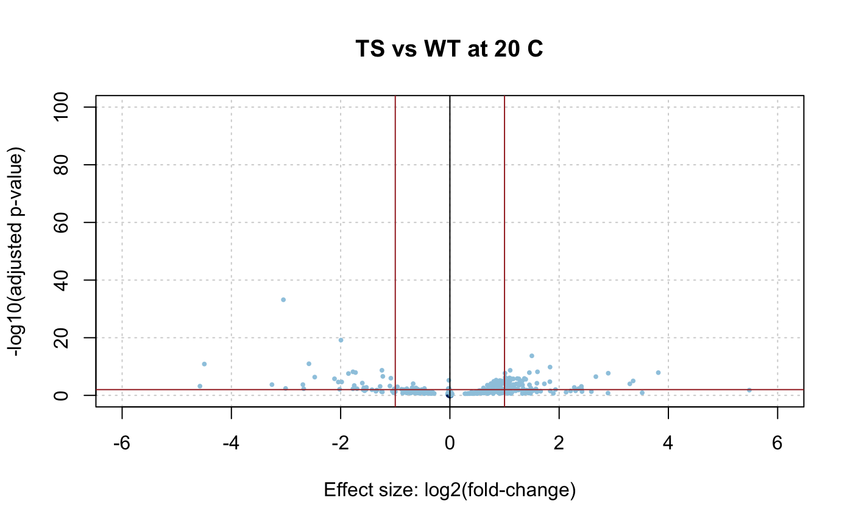
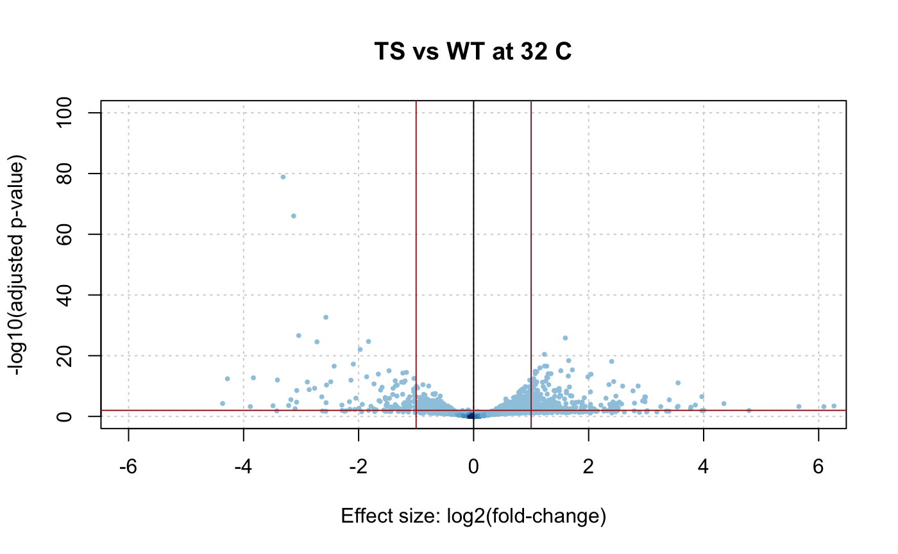
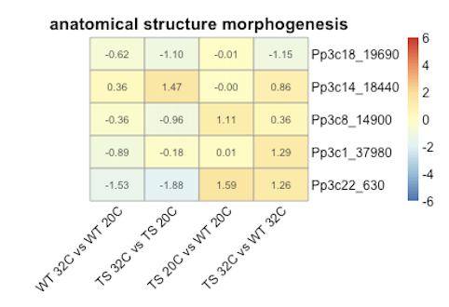
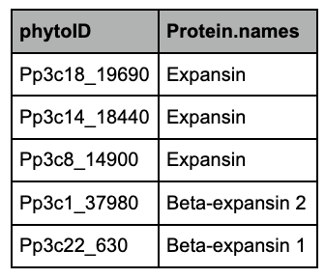
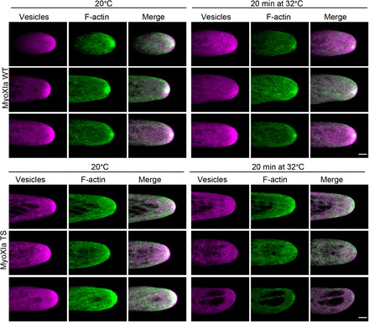
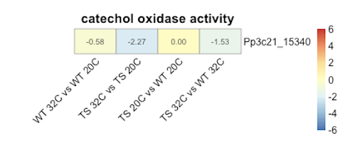
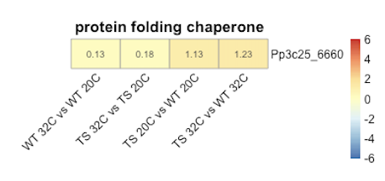
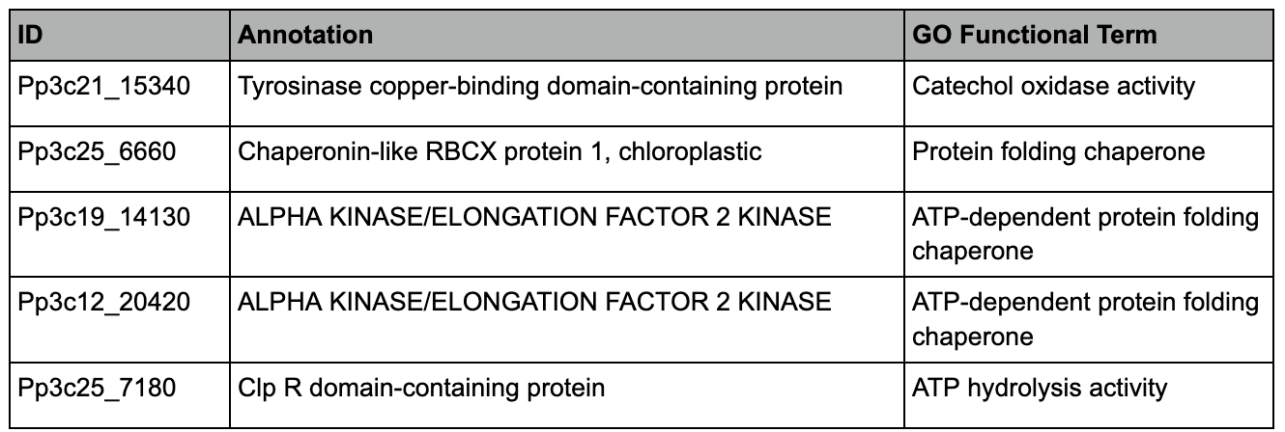
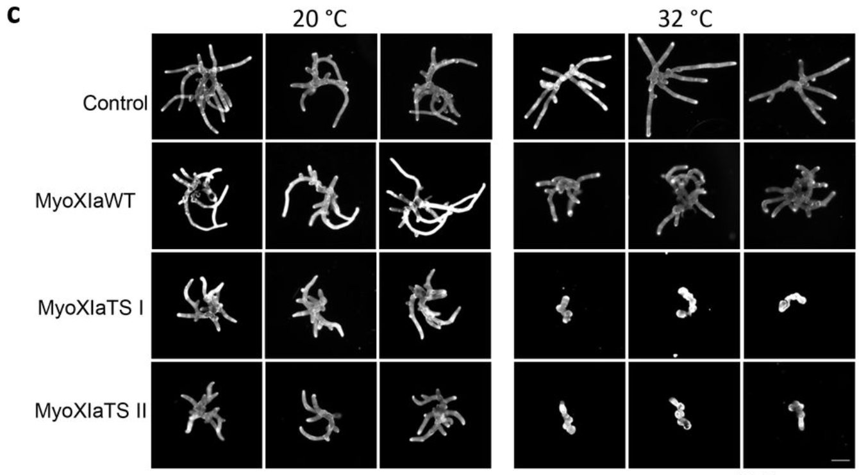
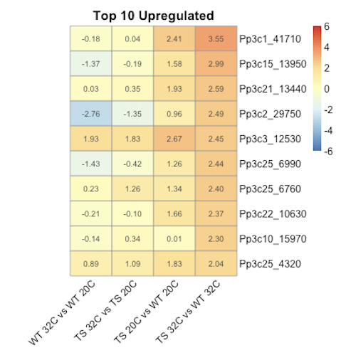
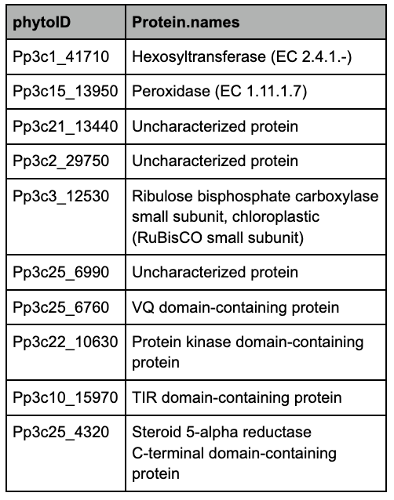
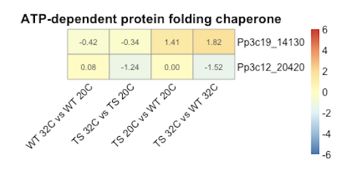
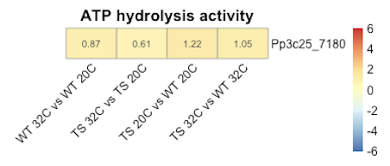
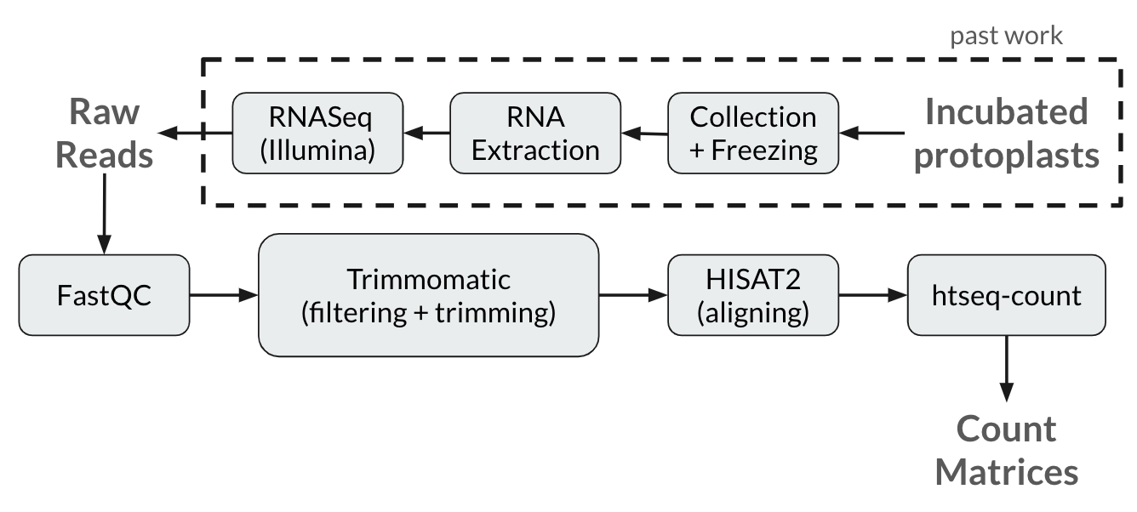
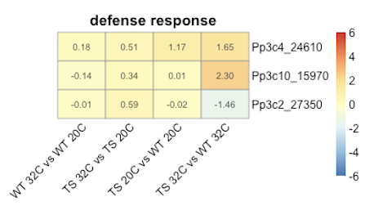
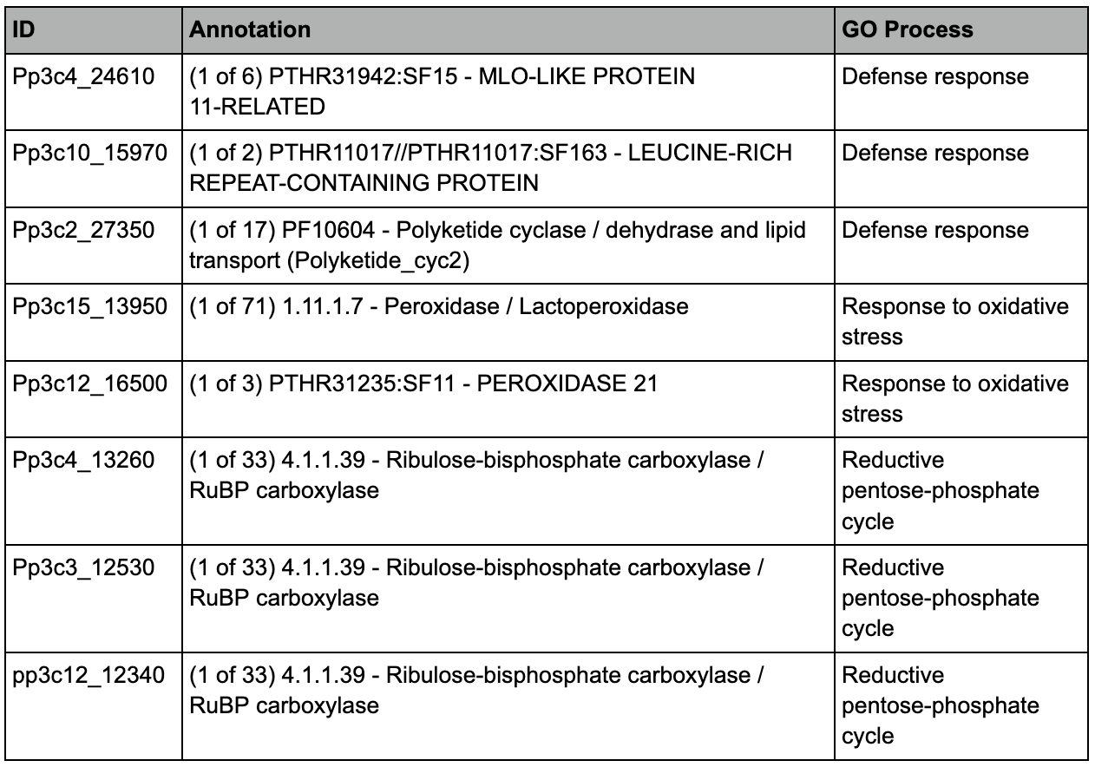
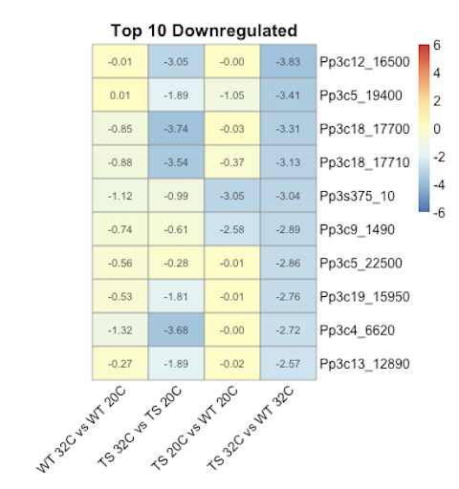
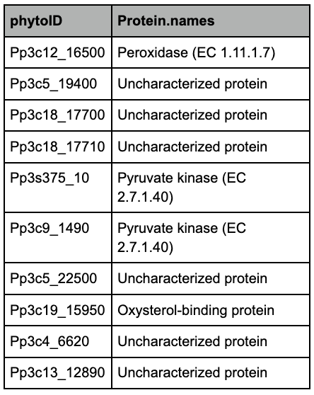
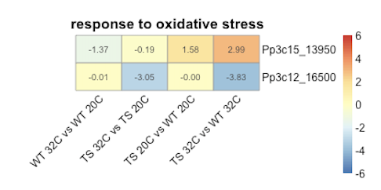
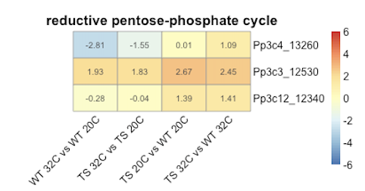
Transcriptomics of Myosin XI
Conditional Loss-of-function in Moss
Bioinformatics and Computational Biology Program
Carter Nakagawa, Luis Vidali (Advisor)
Abstract
Differential Gene Expression
Comparing Heat Response (Process)
Plant biology is a key research topic due to the variety of functions plants perform for our society and in nature. Mechanisms of plant growth on a cellular level are one aspect of this research that is yet to be fully understood. This project specifically explores the role of Myosin XI in Physcomitrium patens tip growth. Transcriptomic analysis of RNA-seq data from a temperature-sensitive MyosinXIa was used to investigate the effects of MyosinXIa loss-of-function on gene expression.
Background
Model Moss Physcomitrium patens
P. patens is an important model in plant biology. It is easy to grow and easy to transform due to its efficient homologous recombination mechanism. This facilitates precise genetic experiments.
Myosin XI and Tip Growth
Tip growth is a key process in all plants. In moss, it occurs in protonemata and rhizoids. Proper tip growth involves polarization of the cell through a variety of processes, including vesicle transport, cell wall mechanics, and cytoskeletal changes. Myosin XI has been implicated as a key factor in tip growth, with the absence or loss of function of it resulting in abnormal tip growth, as shown below.
We hypothesize that Myosin XI loss-of-function results in transcriptome remodeling across key pathways for cell survival and growth.
GO enrichment analysis was done to identify cellular processes significantly enriched in heat response DEG’s. In comparing enriched processes for WT and TS strains, we identified a group of expansin and beta-expansin genes with differing expression between strains. Comparison of other heat response genes shows no significant differences, suggesting this expansin group is a key difference.
Results from RNA-seq analysis shown through MA plots (top), volcano plots (bottom), and log fold change heatmap of all DEG’s
Highly Differentially Expressed Genes
Comparing Heat Response (Function)
Similar analysis was performed using cellular function GO terms, resulting in a few genes across different categories with different expression patterns between strains.
Methods
Comparing WT and TS Directly
Conclusions
The results partially support our hypothesis that Myosin XI loss causes widespread gene expression changes that are important for cell survival and growth.
Some of the key changes were found to be associated with cell processes such as cell wall remodeling and protein folding.
Future work is needed to validate the changes in gene expression of genes identified in this project.
Several uncharacterized genes were found to be highly differentially expressed when Myosin XI function is lost.
This work may provide clues to the function of these uncharacterized genes.
Myosin XIa Mutant
In this project, we analyzed RNA-seq data from MyosinXIa temperature-sensitive mutant. This mutant line has a MyosinXIa allele that induces loss-of-function at a restrictive temperature of 32 C.
Transcriptomic Analysis
Following RNA-seq read processing, we applied bioinformatics approaches to identify differentially expressed genes (DEG’s) and key pathways/processes involved in abnormal tip growth.
Lastly, we performed enrichment analysis to identify key enriched processes in DEG’s between WT and TS strains at 32 C. We found a few more genes with differing expression through this approach as well.
Top 10 over-expressed and under-expressed DEG’s in the TS 32 C vs WT 32 C condition. Tables with gene annotations provided.
Notes:
Add in conclusion on right side bottom
Table same order as heatmap
Emphasize uncharacterized genes in highly up/down regulated
Replace up-close. Tip growth with TS paper figure

Slide 2
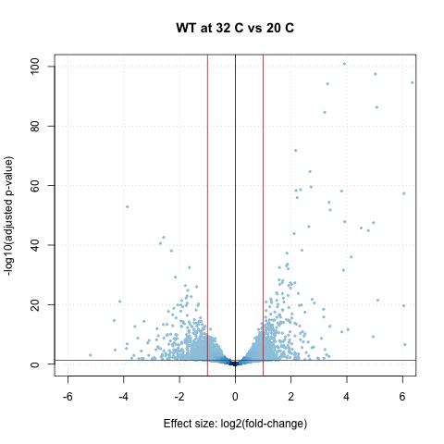
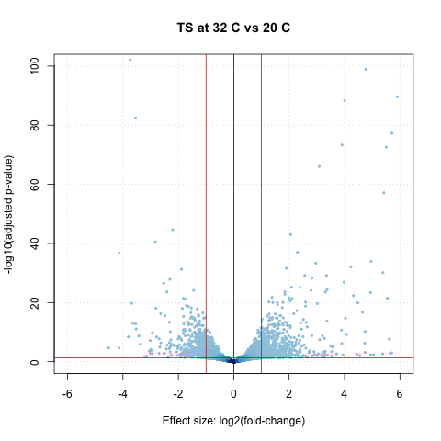
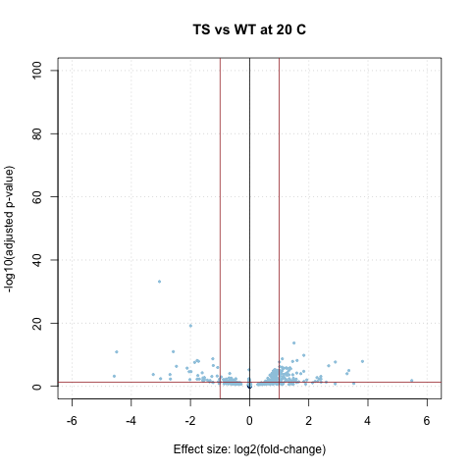
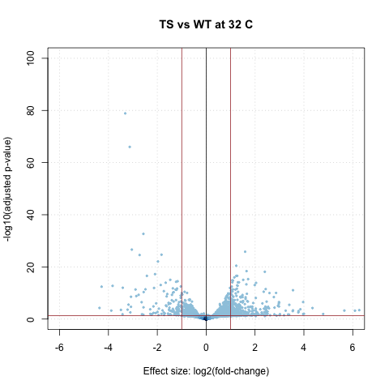
A
B
C
D
Figure 1: Volcano plots for each condition. Cutoffs for DEG’s set at p_{adj} < 0.05 and abs(LFC) > 1.

Slide 3
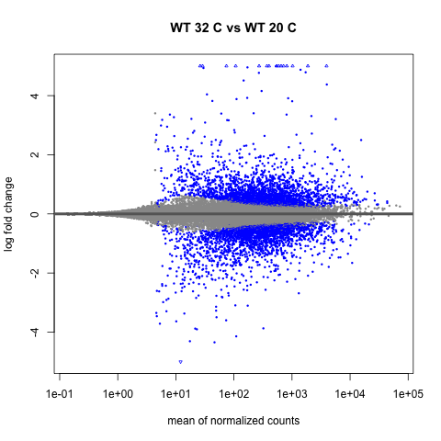
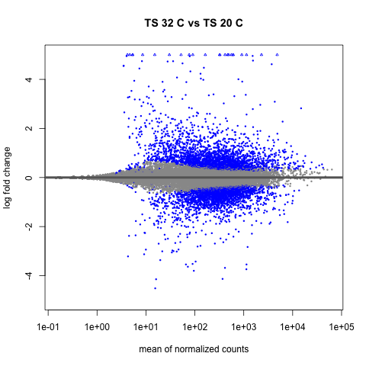
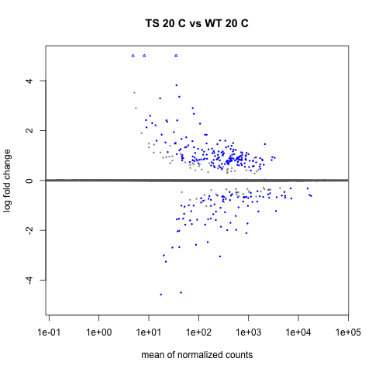
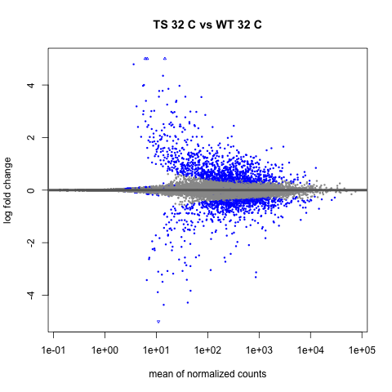
A
B
C
D
Figure 2: MA plots for each condition. Blue points signify genes with p_{adj} < 0.05.

Slide 4
A
B
C
Figure 5: Heatmaps for DEG’s in key heat response enriched categories.

